Slide 1
Invasive Species Prediction
Bharath Sivaram, sivar019@umn.edu, Robotics MS
Pranav Julakanti, julak004@umn.edu, Robotics MS

Slide 2
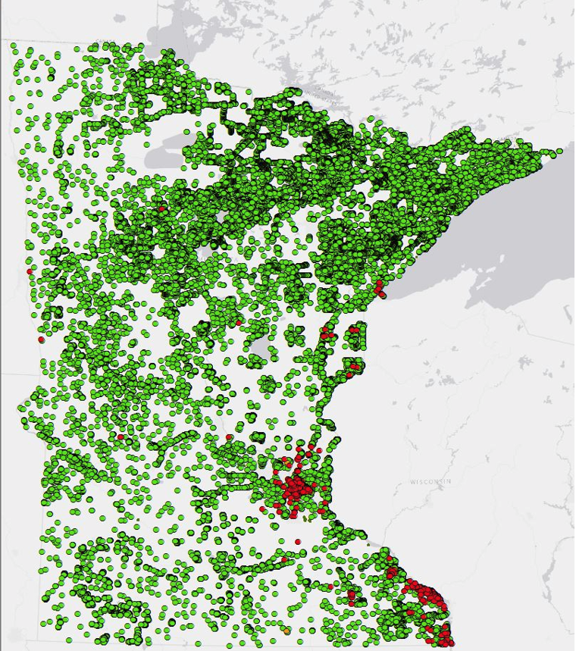
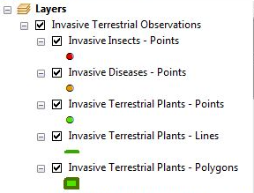
Goal
This project will use territorial invasive species observations to predict the majority species within a certain buffer zone

Slide 3
Current Practice
Traditional methods involve collecting data at the location of interest
This involves going to historically known locations of invasive species (lakes, forest land, etc.)
Time consuming and laborious with involvement of domain experts

Slide 4
Our Approach
First, we will create several buffers and find the top 3 invasive species within those buffers
We will combine the given features with geographic features from OSM
Then, similar to homework 2, we will account for the feature totals within buffer sizes
Note, there isn’t enough features to cluster
Random forest will be used to train and predict
If time allows, a neural network approach will also be attempted and compared

Slide 5
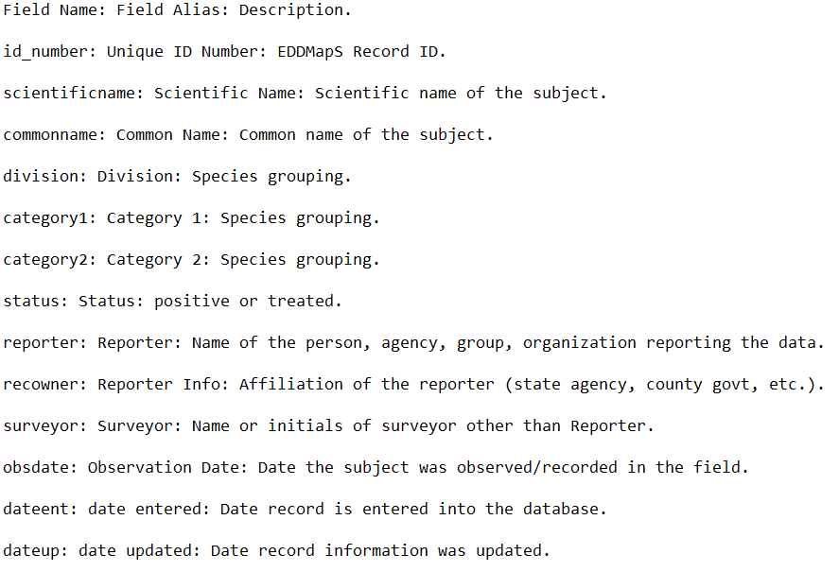
Dataset
We will use a gpkg provided by the Minnesota Natural Resources Department
The dataset includes observations from 2016 to 2021
Various features such as habitat, body type and treatment status are already included

Slide 6
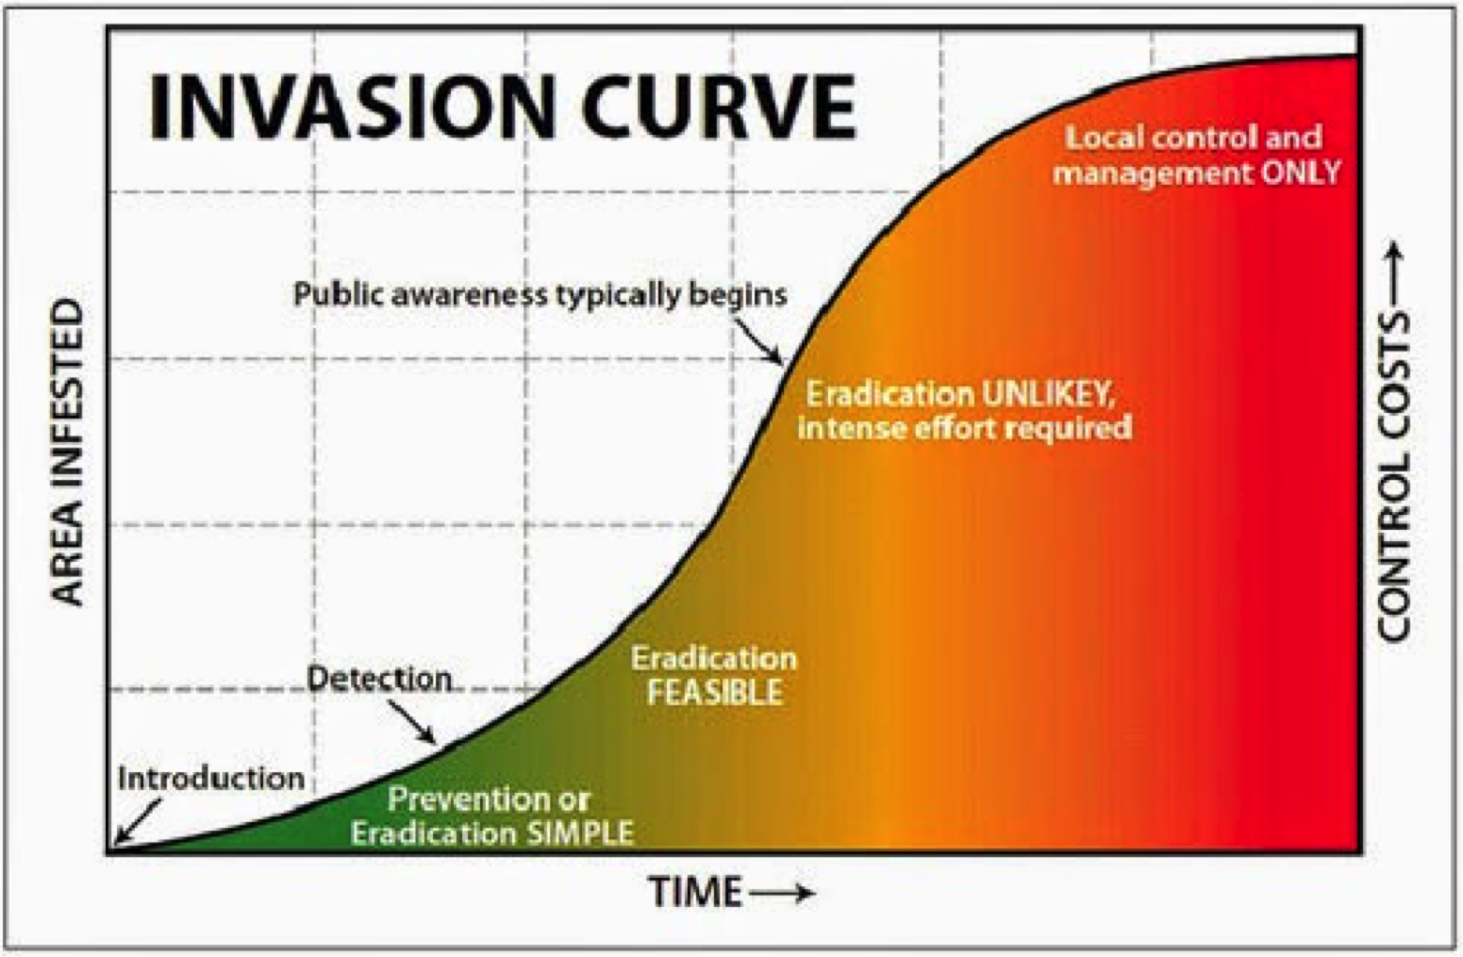
Significance
Will allow for more efficient surveying of areas for invasive species
Allows the state to prepare for extermination should the predictions be accurate
Helps agriculture industry for crop planning should a species be a threat

Slide 7
Metrics
Will use R2 and MSE to evaluate performance
We will split our data into training and validation sets

Slide 8
Sources
https://gisdata.mn.gov/dataset/env-invasive-terrestrial-obs
https://northeastaquaticresearch.net/education/invasive-species-management/

